Slide 1
Advanced Computer Systems Final Project
Dan Fiumara

Slide 2
All Digital Phase Locked Loop
ADPLL allows us to synchronize periodic signals
  Ensure accurate clock signal distribution in large scale digital circuits
  Enable multiphase clock signal generation
  Reduce phase noise in communication systems
  Demodulate frequency modulated signals
  Clock Deskewing in communication buses
  Etc.
ADPLL’s are essential to high performance computing systems

Slide 3
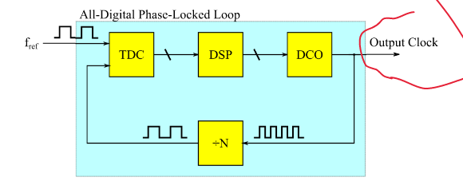
All Digital Phase Locked Loop – Feedback System
Measure phase noise
Convert phase noise measurement to a control signal
Adjust a digitally controlled oscillator with the control signal

Slide 4
Design Task
Not enough time to implement a full ADPLL
Focus on the Time to Digital Converter

Slide 5
Time to Digital Converter (TDC)
TDC measures the time elapsed between two events
TDC’s have tons of applications
  ADPLL
  Time of Flight Sensors (ToF)
  Experimental physics measurements (measure particle speed)
  Medical Imaging
  Etc.

Slide 6
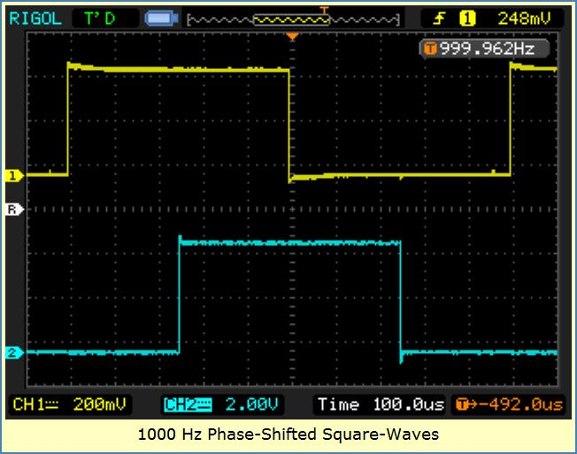
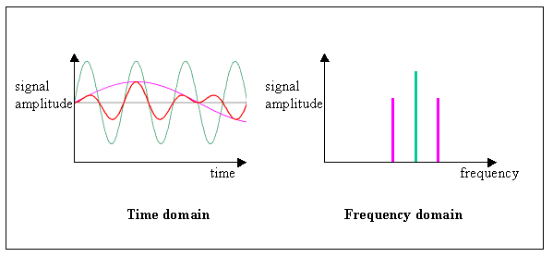
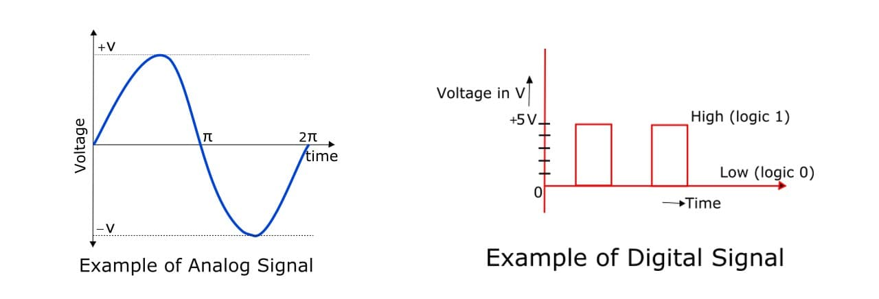
Time to Digital Converter
Signal Domains

Slide 7
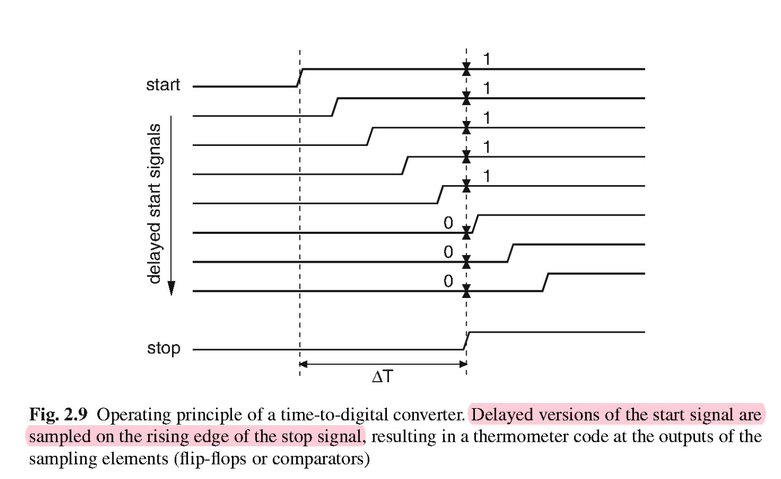
TDC Design
Goal: Measure the time elapsed between two pulses
Tool: Pulse Arbiter
  Determine which of two pulses occurs first
  Simple Flip-Flop implementation
Tool: Delay Element
  Delay an input pulse by a given amount of time

Slide 8
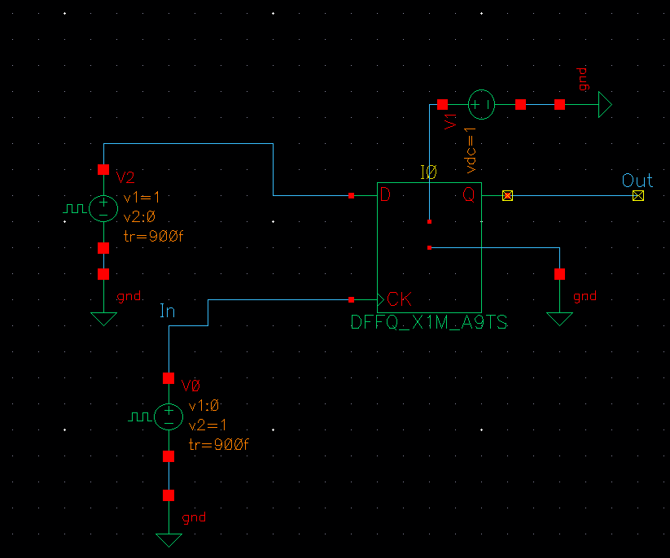
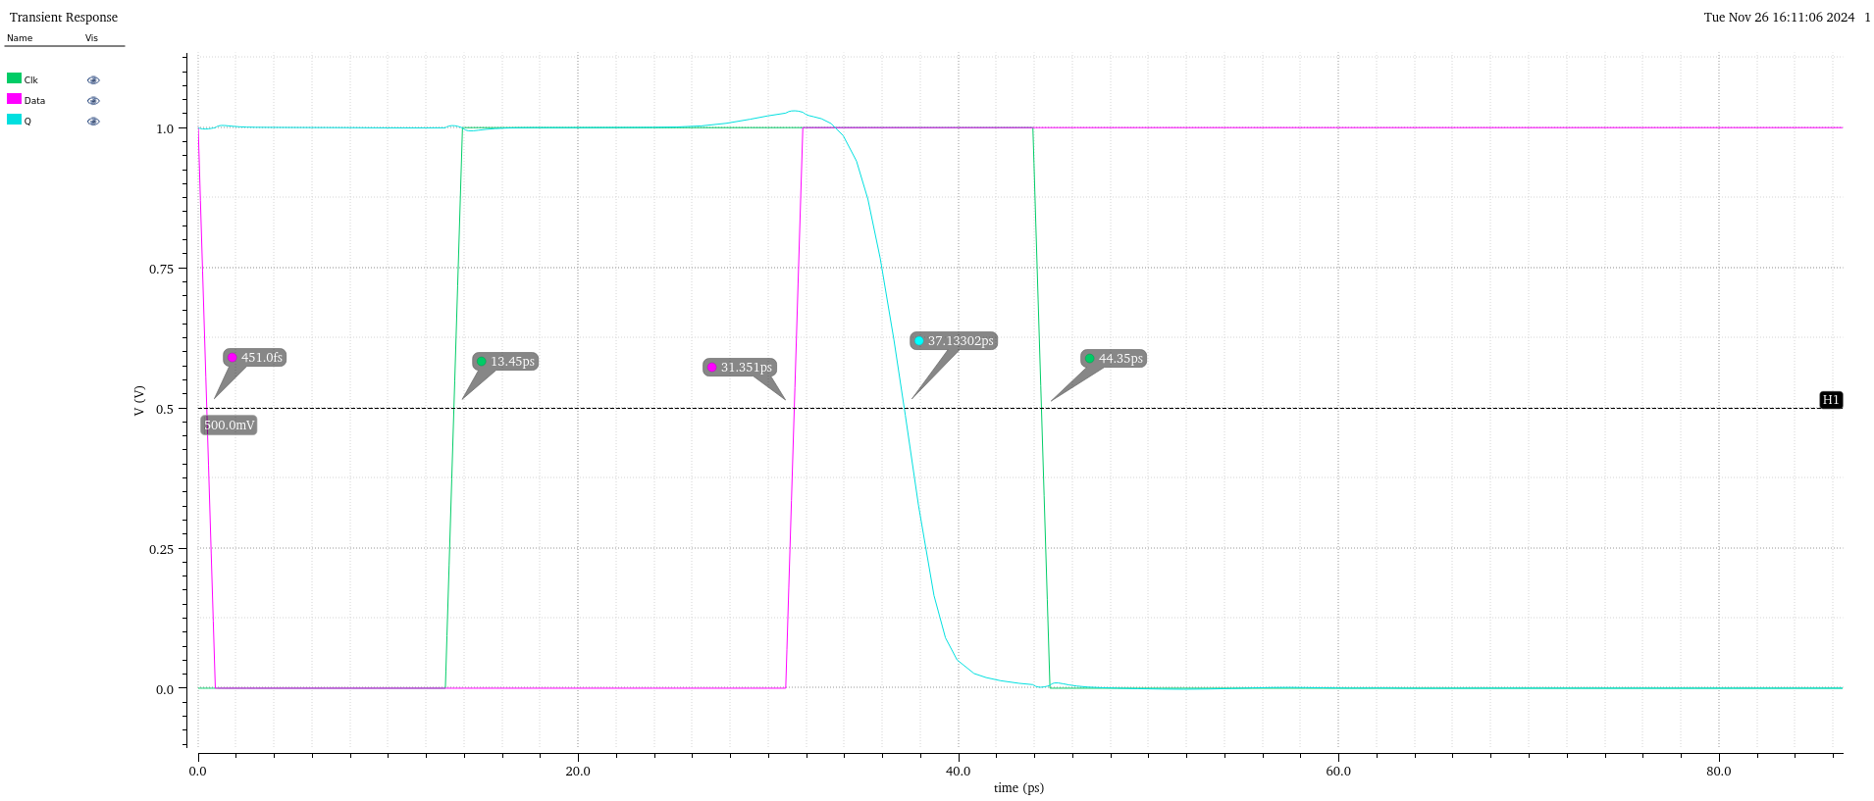
TDC Design - Arbiter

Slide 9
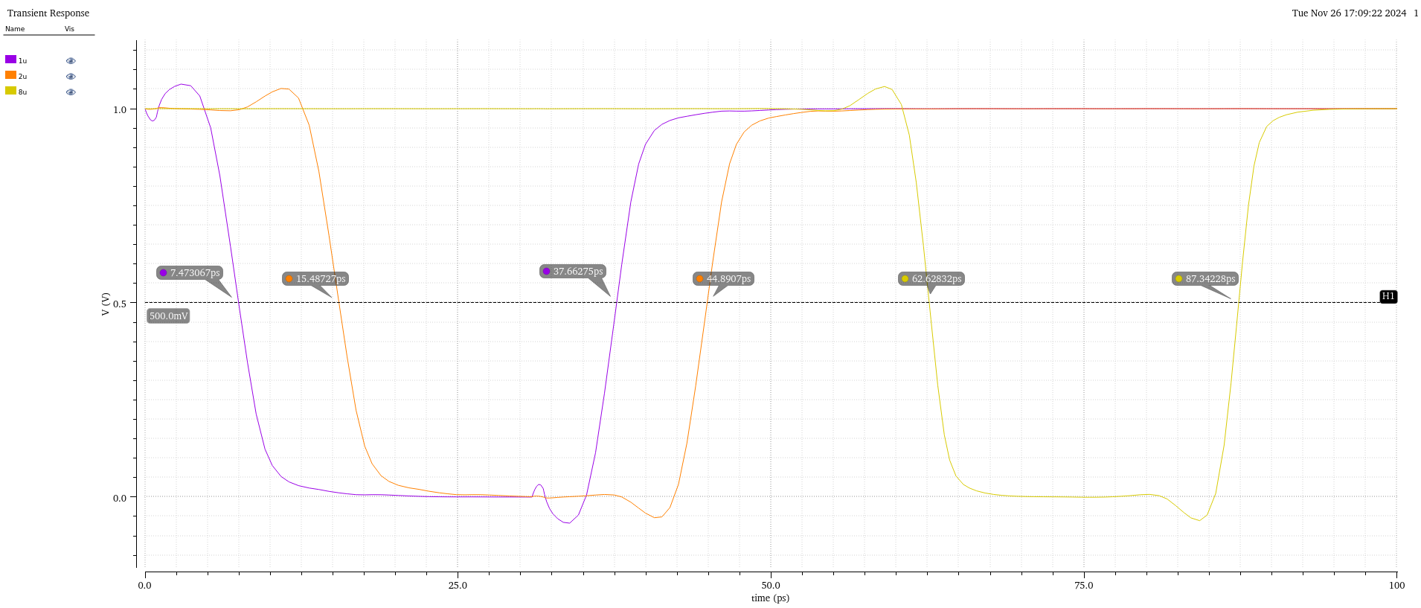
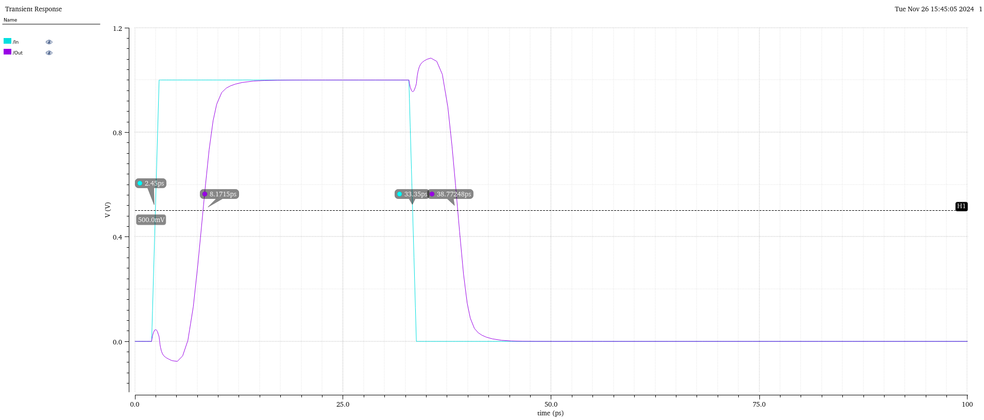
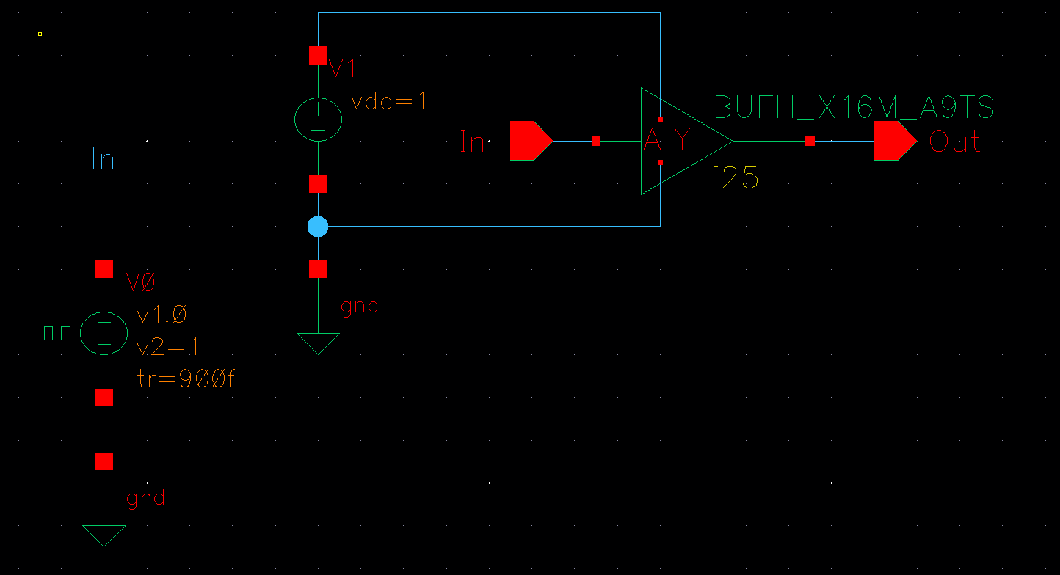
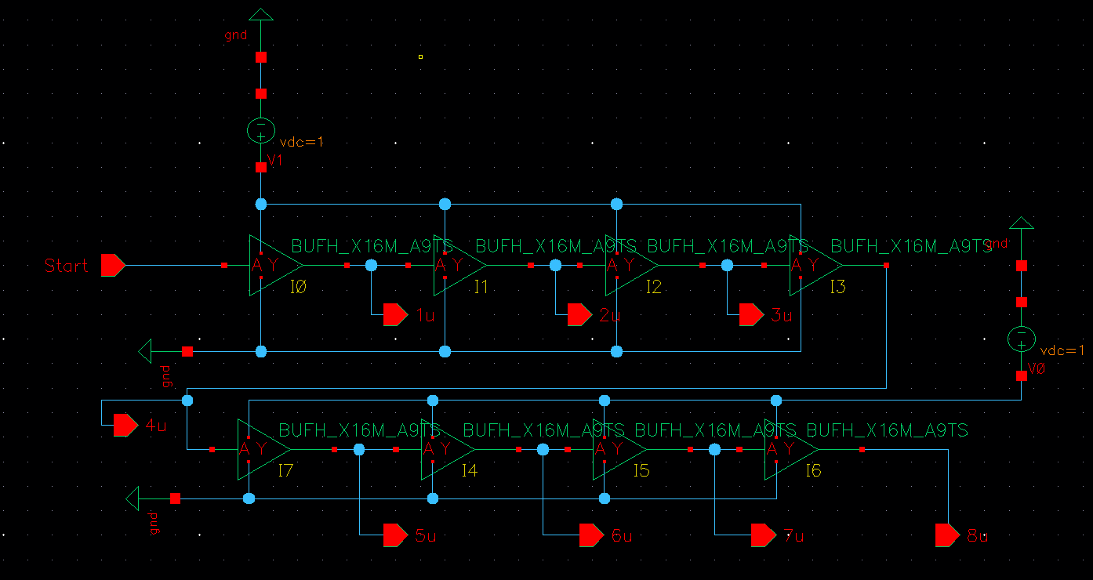
TDC Design – Delay Line

Slide 10
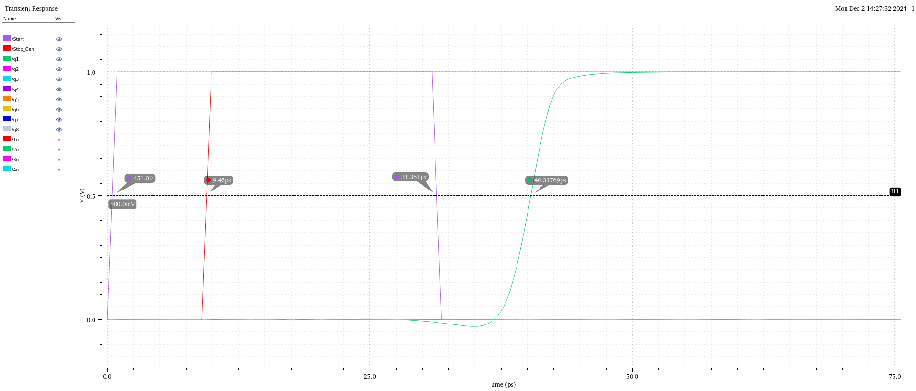
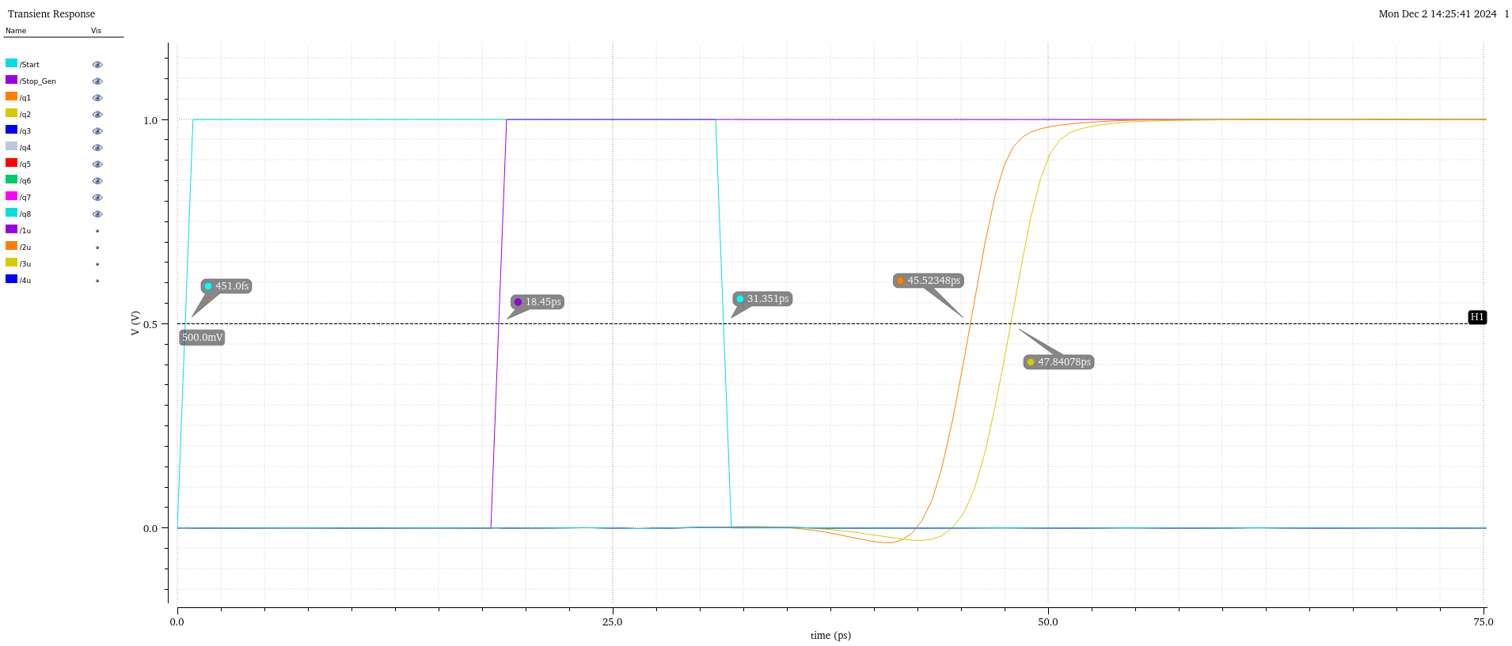
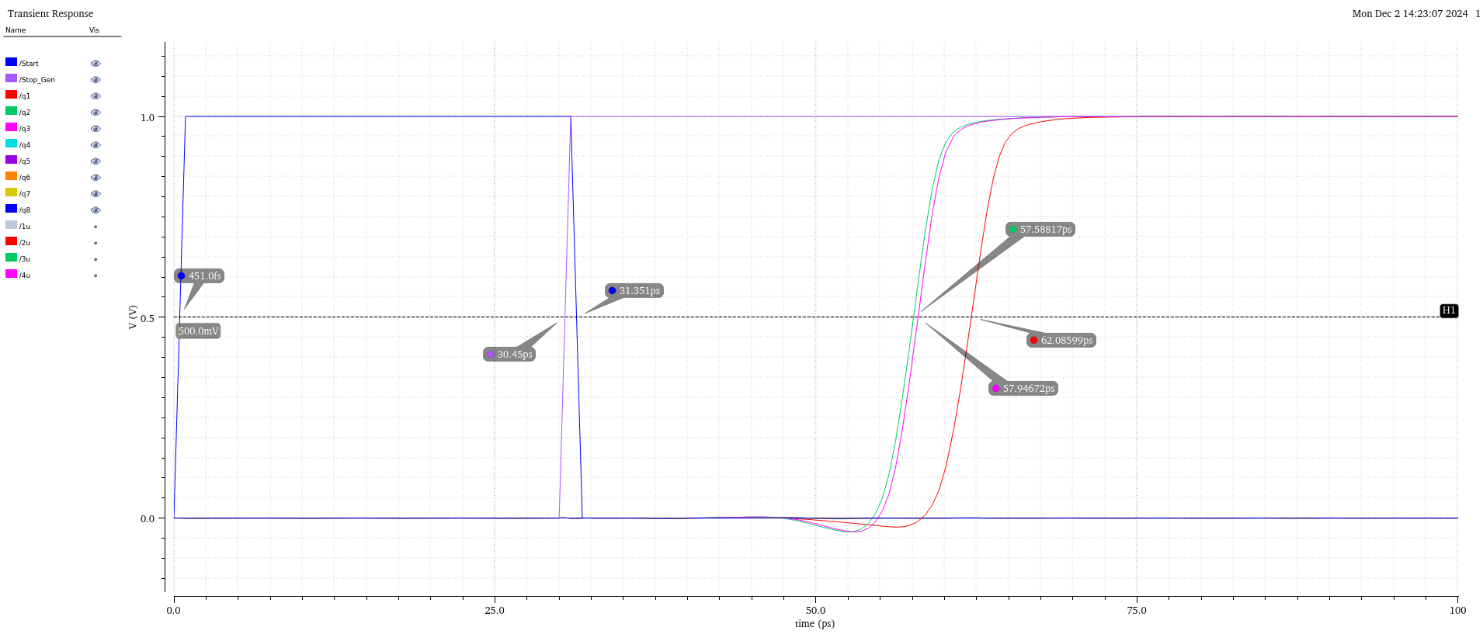
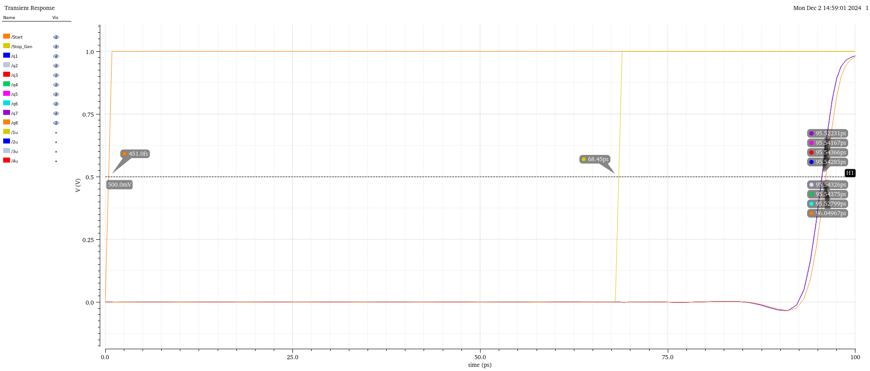
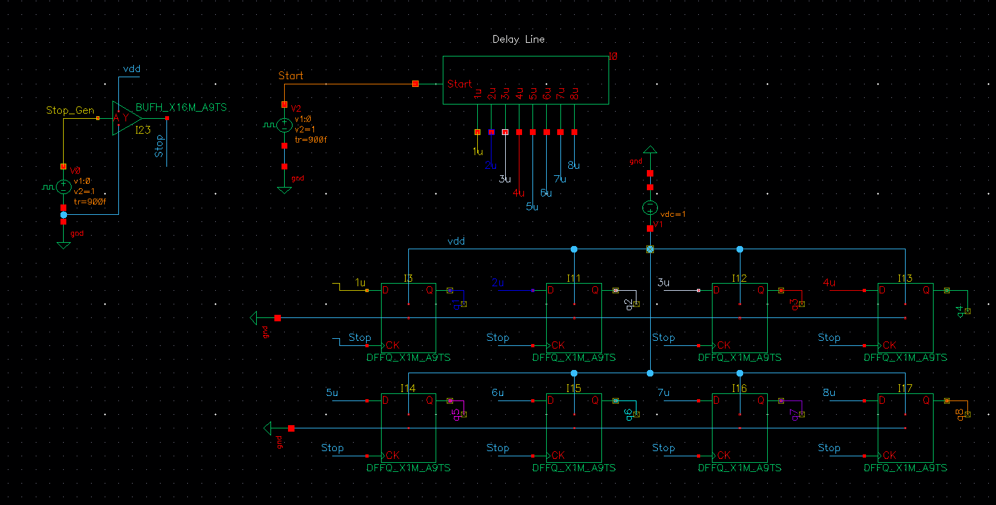
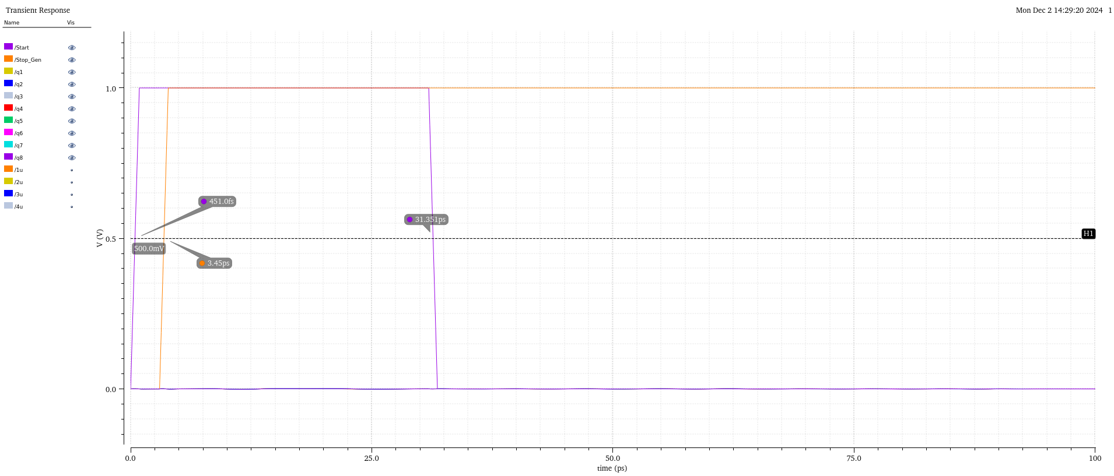
Basic TDC Top-Level Schematic

Slide 11
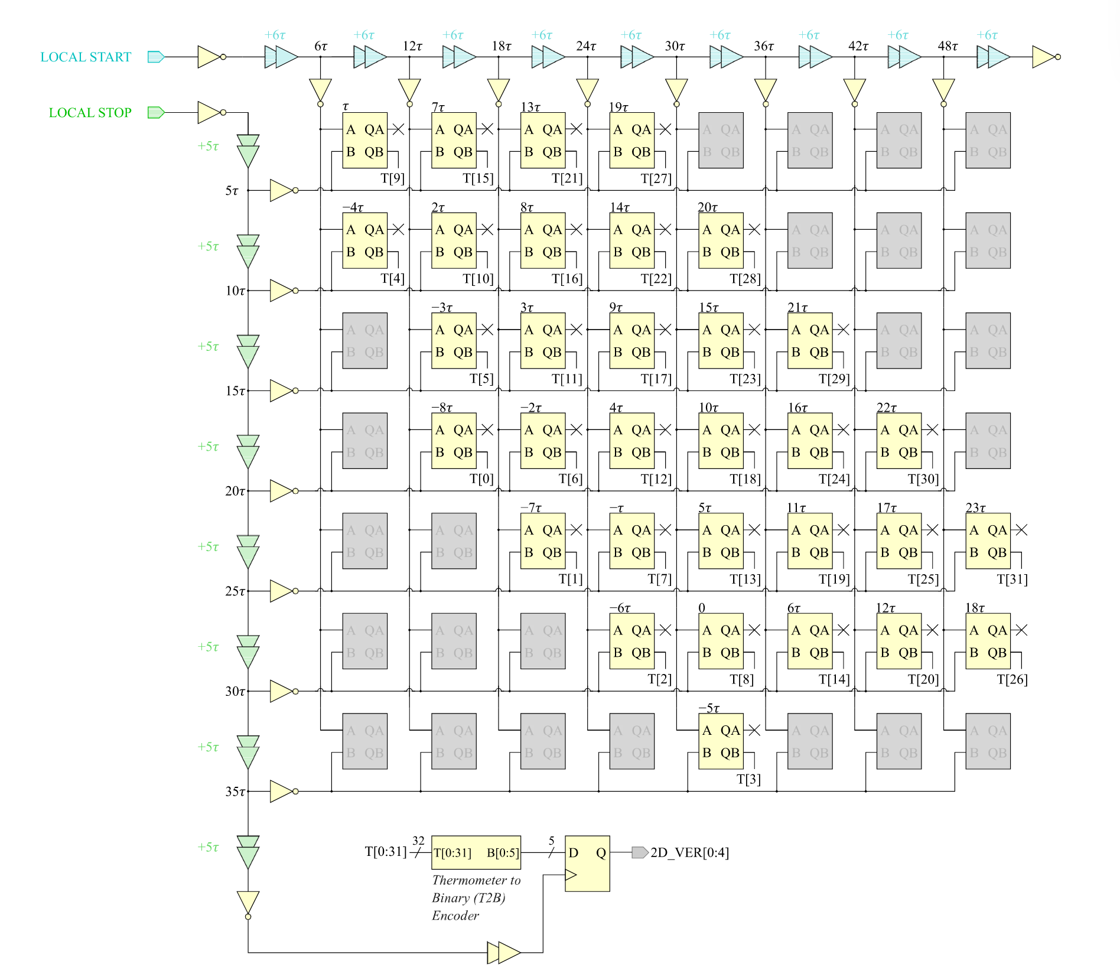
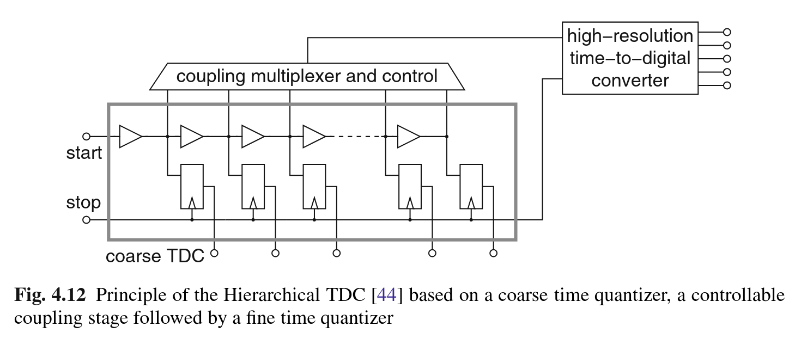
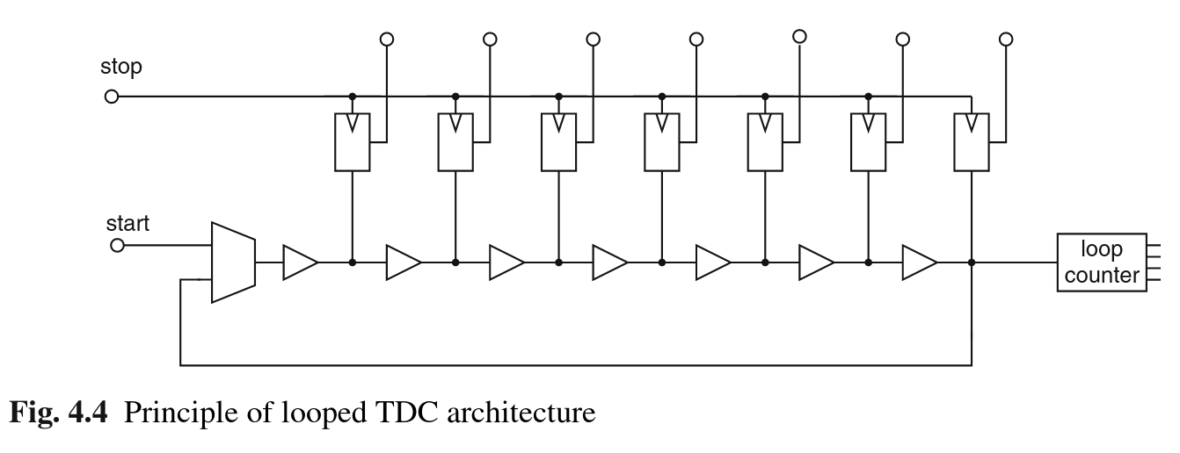
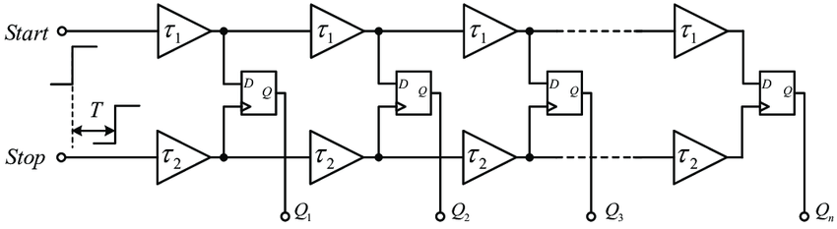
Time to Digital Converter (TDC) Design Improvements
Folded Delay Line (Ring Buffer)
Vernier Delay Lines
2D Vernier Delay Lines
Hierarchical measurement (course, fine circuits)

